Slide 1
Android UI Automator
Alex LI

Slide 2
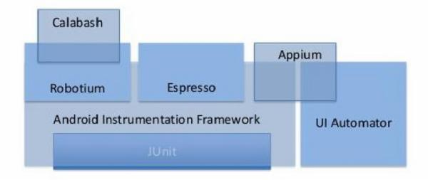

Slide 3
UI Automator
Project Intro:
Motivation;
Project Architecture;
Deliverables;
Project QA:
Test scope and strategy;
Automation test framework:
Android Instrumentation;
Command-line tool;
IF Test cases Management tool;
Demo

Slide 4
IF – Project Intro
Pain points:
Have created many SW players for different purposes for many years:
Content creation workflow, trade show, sales demos, listening test etc;
Typically project focused, different architecture, codec support, OS support;
Targets:
Provide a cross platform player integration env with an unified architecture;
Android, iOS, OS X, Windows;
Consider common requirements from internal stakeholders:
Gravity, DUP/DRP, DS1, Avocado, Mandarina;
Create a flexible infrastructure to support player product integration:
Notes:
Pain points:
Disjoint;
Different architecture;
Hard to extend/reuse by other teams;
IF Targets:
Stakeholders will take IF and extend it for their specific product deliverables;

Slide 5
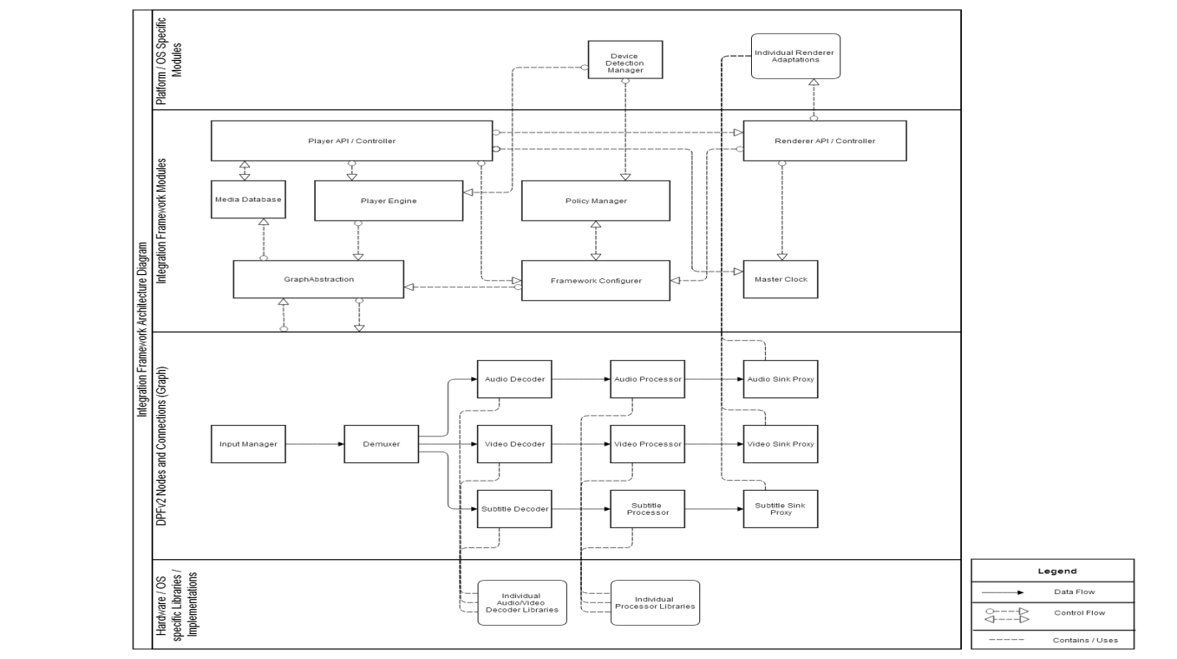
IF – Project Intro
Architecture:
Hardware specific libraries;
DPFv2;
Abstraction Layer;
OS/Platform specific Impl;
Notes:
Layered Architecture:
Hardware specific libs: Includes optimized libs for different platform; e.g. DD+ or DAP Decoders for Android -> ARM optimized;
DPFv2: A generic processing framework which provides a set of software API used for audio and video processing, look like Gstreamer or DirectShow
Abstraction layer: Abstracts DPFv2 layer and its processing nodes, provides platform indepentdent player API to upper layer;
OS/Platform specific Impl: contains rendering abstraction, different platform uses different way to render data;

Slide 6
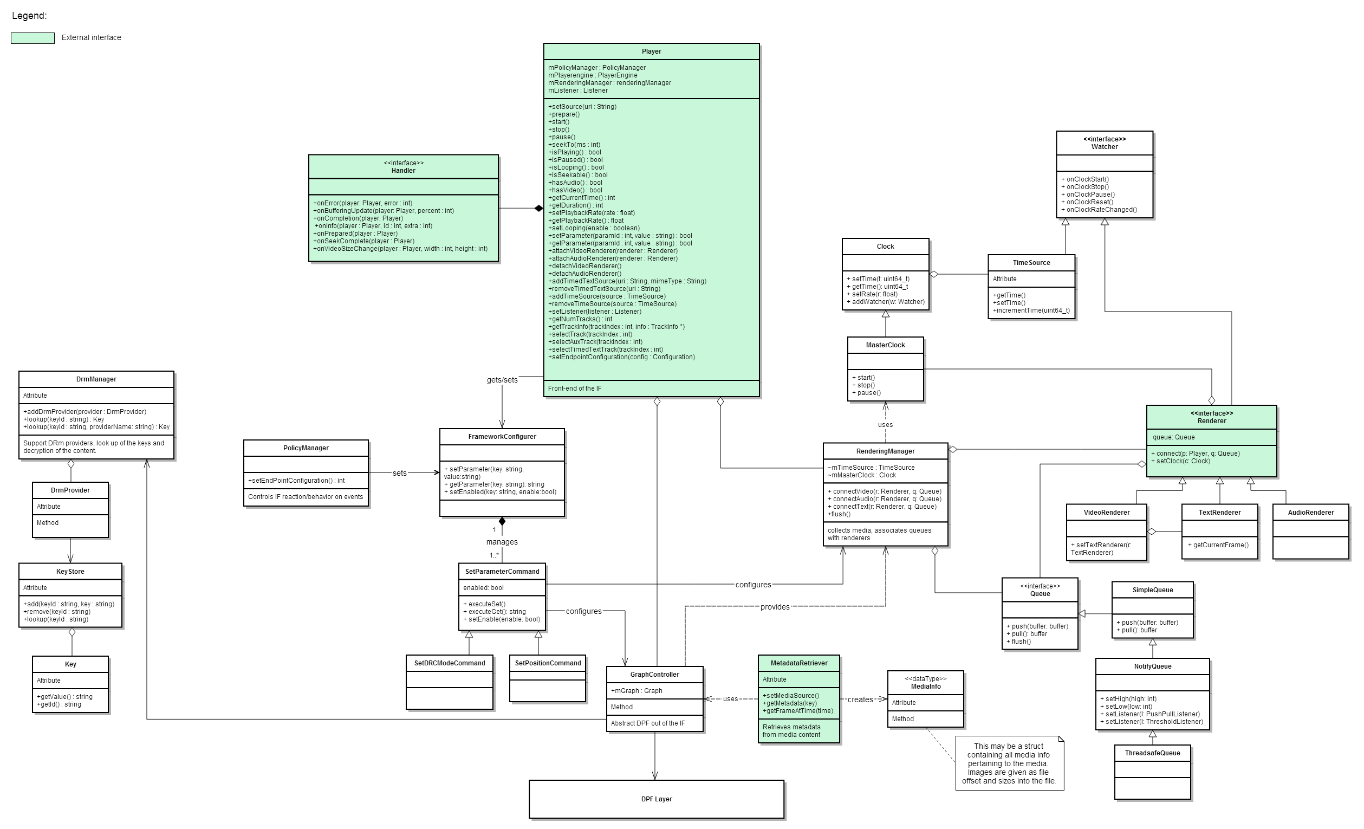
IF – Project background
Class diagram:
Notes:
Class components which are marked as green are external components:
Player;
Event handler;
Renderer;
MataData Retriever;
All the components in DPFv2 layer are transparent to upper layer;
Platform-independent layer, interface between the underlying component and platform layer, different platform needs to extend it;

Slide 7
IF – Project Intro
Deliverables:
Platform independent source code(C++):
Platform specific API:
Android: Java;
Windows: C#, C++;
Mac OS/iOS: Objective-C;
API doc;
Notes:
Ship platform-independent code to internal customers:
As flexible as possible;
Add their own codec to underlying framework;
Platform specific API:
Wrap all the external components of abstraction layer with platform-related mapping technologies(e.g: Android -> JNI)
API doc;
Internal customers can refer it to write their own player;

Slide 8
IF – Project QA
Test scope:
Platform-specific API:
Methods;
Event handling;
Error handling;
Media playback:
A/V Sync;
Local/Adaptive stream playback;
FPS;
Performance:
CPU usage, Memory usage;
Listening test;
API doc;

Slide 9
IF – Project QA
Test strategy:
API testing:
Automated;
Playback testing:
Short term: Manual;
Still investigating some playback measurement tools;
Listening test:
Reuse/integrate in-house tools are being used by other teams;
API doc check:
Manual check;

Slide 10
IF – Project QA
Automation test framework:
Proposals:
Google Test;
pyTest;
ITAF;
Targets:
Testers can write platform-specific API of IF by writing platform-specific test code;
The test execution can be triggered from a command-line interface which provides flexible options;
Test results can be logged to Test link automatically;
The framework should provide interface for Continuous test;

Slide 11
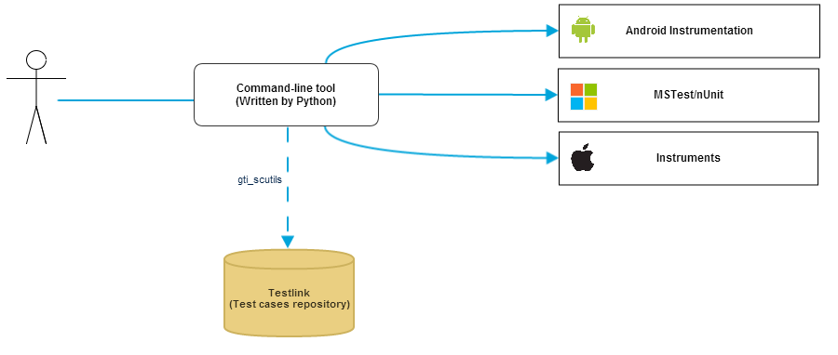
IF – Project QA
Automation test framework:
Structure:

Slide 12
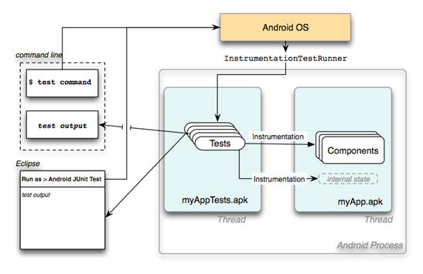
IF – Project QA
Android Instrumentation:
Why Instrumentation:
A test framework which extends from standard JUnit framework;
Easy to write function, system and acceptance test cases;
Can be integrated with Maven or Ant to run tests as part of Continuous integration;
Notes:
Workflow:

Slide 13
IF – Project QA
Android Instrumentation:
Known issues:
No file-based test report output;
Not stable sometimes, one test exception may lead to Instrumentation runner crash;
Mismatch of test priority classification:
Android Instrumentation: Small, Medium, High;
Test link: Low, Medium, High;
Solutions:
Rewrite default runner, make it generate JUnit format test report can be identified by Testlink;
Run test cases one by one, then combine the individual results to a single one;
Replace the default annotations with the customized annotations;
//depot/qa/tools/android_qa_common;

Slide 14
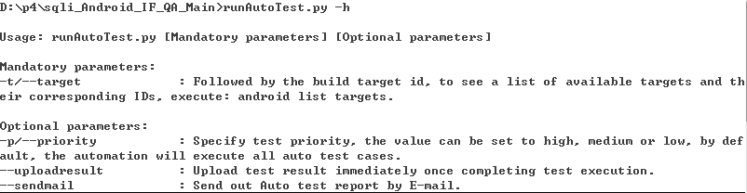
IF – Project QA
Command-line tool:
Features:
Auto building Product code;
Importing test results to Test link automatically;
Test report generating by E-mail;
Options:

Slide 15
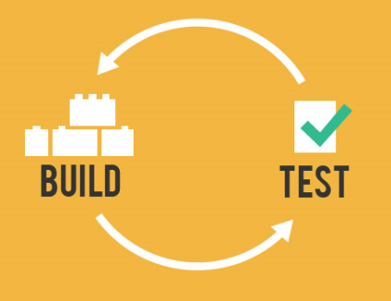
IF – Project QA
Command-line tool:
Continuous test:
Reduce risks;
Enable better project visibility;
Generate deployable software at any time and at any place;
Establish greater confidence in the SW product;
Build it fast, build it well, test it often, then ship it;
Notes:
Any small change can be identified soon:

Slide 16
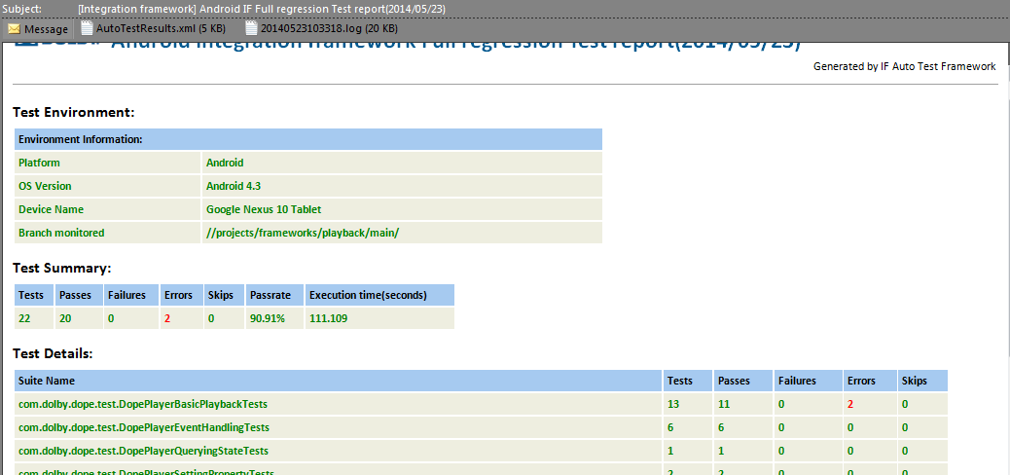
IF – Project QA
Command-line tool:
Continuous test:
Notes:
Any small change can be identified soon:

Slide 17
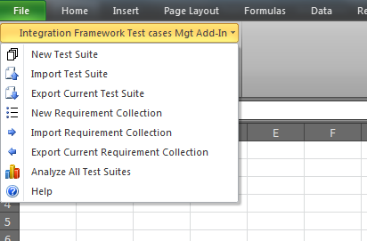
IF – Project QA
IF Test cases Management tool:
Purpose:
Merge the test cases edit and management in the same entry;
Consider the future expansion for IF;
Functionalities:
Create test suites;
Create requirements;
Export test suites with/without requirement ID association;
Test suites analysis;

Slide 18
Demo
Notes:
Any small change can be identified soon:

Slide 20
Thank you!
Notes:
Any small change can be identified soon:

